Slide 1

Automating Attendance Tracking with Dlib Face Recognition

Slide 2
CONTENTS
ABSTRACT
INTRODUCTION
LITERATURE SURVEY
MOTIVATION
METHODOLOGY
RESULT
CONCLUSION
REFERENCES

Slide 3
ABSTRACT
Revolutionizing attendance management, our 'Automating Attendance Tracking with Dlib Face Recognition' leverages cutting-edge facial recognition technology, notably Dlib's pretrained neural network. With unparalleled efficiency and accuracy, our system eliminates manual documentation and verification, reducing errors and enhancing administrative workflows. Seamlessly integrating demographic data, it enables personalized attendance monitoring and insightful analysis. By harnessing deep learning algorithms, organizations can make data-driven decisions and optimize resource allocation. Scalable and reliable, our solution caters to diverse sectors and educational institutions, representing a significant advancement in attendance management.

Slide 4
INTRODUCTION
The project revolutionizes traditional attendance tracking through advanced technologies like machine learning and computer vision. By integrating React frontend with Django backend, we offer a seamless interface for real-time face detection and capture. Our system automates attendance management, leveraging facial recognition and OpenCV techniques alongside a robust database structure. This fusion of cutting-edge technology with extensive web development expertise enhances organizational efficiency, optimizes resource utilization, and boosts overall productivity. Rigorous testing validates the scalability, practicality, and reliability of our solution, paving the way for widespread adoption and transformative impact on workforce management practices.

Slide 5
LITERATURE SURVEY
[1] Kishan Kushwaha et al. underscores the significance of machine learning (ML) implementation in attendance management systems, particularly in face recognition technology. ML algorithms, such as Convolutional Neural Networks (CNNs) and Support Vector Machines (SVMs), are crucial for accurate identification and attendance marking. Their utilization ensures efficient and reliable automation, enhancing the overall effectiveness and convenience of attendance management processes in educational institutions.
[2] Ainampudi Kumari Sirivarshitha et al. delves into the significance of facial detection and recognition using Python libraries like OpenCV. It highlights the crucial role of automated understanding in various fields. The proposed approach focuses on image quality enhancement and explores future applications in IoT environments, particularly in security and access control systems.
[3] Nivedhitha DP et al. proposes a Smart Attendance System using Dlib pre-trained neural network, enhancing facial recognition with HOG and SVM. It automates attendance marking in Google Sheets, ensuring contactless verification. The system's versatility extends to various sectors, including education, healthcare, and security, with a focus on pandemic safety.

Slide 6
LITERATURE SURVEY
[4] Prof. Deepali Joshi et al. The paper presented at ICNTE 2023 proposes a face recognition-based attendance system using OpenCV. It utilizes the LBPH algorithm for recognition and Haar Cascade for detection. The system captures images, trains the model, recognizes faces, and records attendance automatically. Future improvements include cloud storage integration and potential use in ATM machines.
[5] Kunal Ugale et al. The paper proposes a real-time monitoring system for ensuring the safety of schoolchildren during bus rides, employing image processing techniques like face detection and recognition. It utilizes OpenCV, Wi-Fi, and deep learning methods for efficient attendance management. The system architecture, implementation details, and future scopes are discussed, promising enhanced safety and attendance accuracy.

Slide 7
MOTIVATION
In today's rapidly evolving world, technological advancements are reshaping our daily lives, including how we manage attendance. With the implementation of state-of-the-art facial recognition technology, our aim is to revolutionize traditional attendance tracking methods, enhancing accuracy, efficiency, and productivity. Our objective extends beyond mere convenience; we aspire to equip organizations with tools to make informed decisions, streamline resource allocation, and cultivate a culture of accountability. Through this seminar, we seek to inspire innovation, drive positive transformation, and contribute to the progress of modern society.

Slide 8
METHODOLOGY
A. Data Collection:
Obtain employee face dataset from business databases
Multiple photos per employee stored in designated directories
Ensure dataset robustness and correctness
B. Data Preprocessing:
Subset creation: training, validation, test sets
Standardization: scaling, normalization, grayscale conversion
Objective: enhance dataset quality, aid model learning process

Slide 9
METHODOLOGY
C. Model Selection:
Libraries: OpenCV, face_recognition, Django framework
Utilize CNNs for facial feature extraction and classification
Pre-trained models for real-time face detection and recognition
D. Data Augmentation:
Improve deep learning algorithms' performance
Add variations to existing photos
Geometric modifications: rotation, shearing, zooming
Enrich dataset for better face identification accuracy

Slide 10
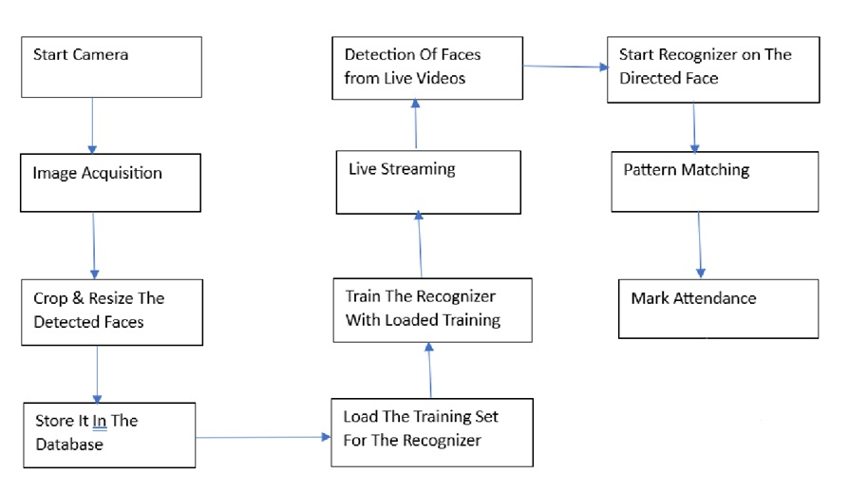
METHODOLOGY
E. Model Training and Evaluation:
Extensive training and evaluation procedure
Utilize facial recognition algorithms for live video stream
Reduce binary cross-entropy loss for improved discrimination
Assess discriminatory power with ROC curves, AUC values
Ensures reliability and efficiency of facial recognition-based attendance system

Slide 11
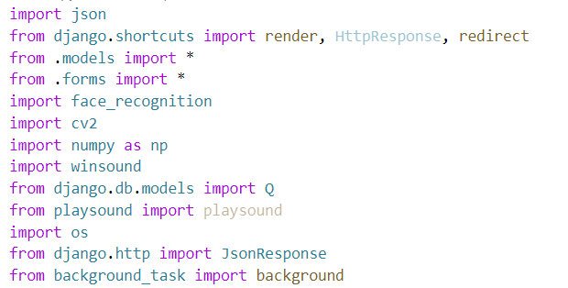
METHODOLOGY
F. Import statements

Slide 12
METHODOLOGY
G. Integration and User Interface:
Front-end interface: React.js
Back-end: .NET, SQL Server
Face recognition component transfers data to front-end
Real-time updates for intuitive user interaction
.NET backend ensures accuracy and consistency of attendance data

Slide 13
RESULTS
Core functionality: based on pretrained models from dlib, specifically the face_recognition model
Decision based on strong image processing and classification capabilities of deep learning architectures, particularly Convolutional Neural Networks (CNNs)
CNNs crucial for accurately recognizing faces by identifying spatial hierarchies of features within input data
CNNs include convolutional, pooling, and fully connected layers for feature extraction and analysis
Solution effectively monitors attendance through real-time facial recognition
Utilization of pretrained models improves efficiency in work environments
System supports dynamic amount of face images, allowing customers to improve accuracy by adding more photographs

Slide 14
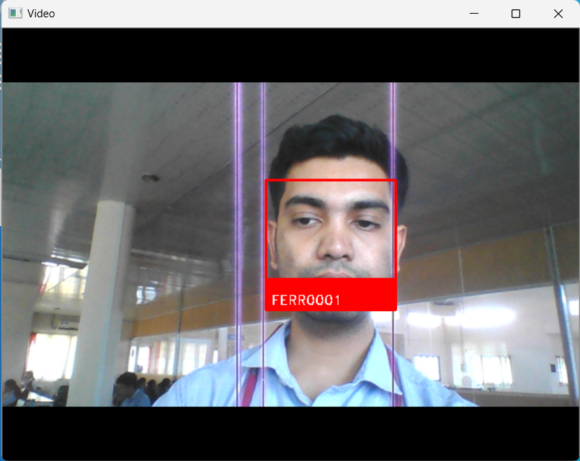
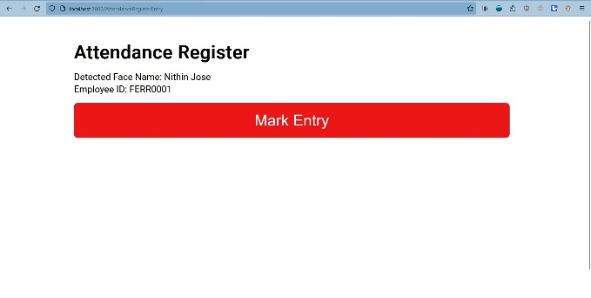
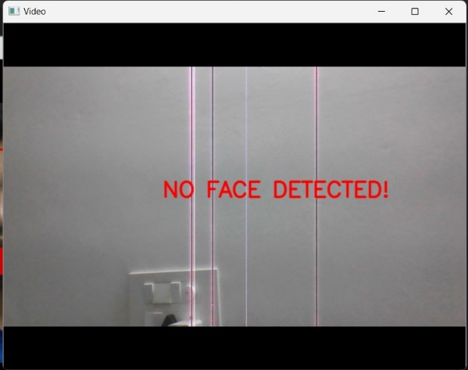
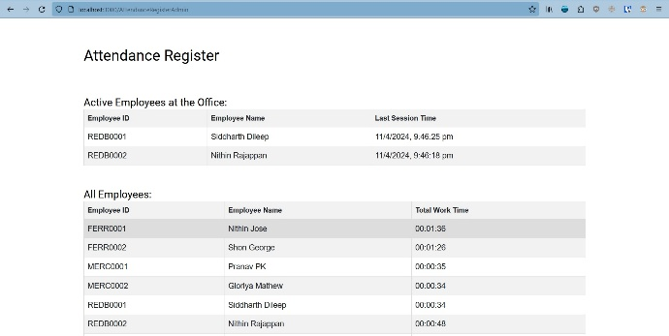
RESULTS

Slide 15
CONCLUSION
Development of facial recognition attendance register marks a significant advancement in attendance control systems.
Fusion of cutting-edge facial recognition technology with Django backend and React frontend frameworks.
Effective application of computer vision algorithms enhances system functionality.
Real-time identification of individuals eliminates manual input, streamlining attendance monitoring.
System ensures convenience and accessibility, reducing administrative strain and boosting productivity.
Extensive testing demonstrates system's efficacy and dependability.
Pretrained models contribute to elevated accuracy rates in various conditions.
Sets a standard for leveraging technology in administrative tasks.
Commitment to ongoing improvement for enhanced usability and efficiency in attendance management.

Slide 16
REFERENCES
[1] Kishan Kushwaha et al. Proceedings of the Fourth International Conference on Smart Electronics and Communication (ICOSEC-2023), Research Title “ A CNN based Attendance Management System using Face Recognition”, [2023]
[2] Ainampudi Kumari Sirivarshitha et al. 9th International Conference on Advanced Computing and Communication Systems (ICACCS), Research Title “ An approach for Face Detection and Face Recognition using OpenCV and Face Recognition Libraries in Python” [2023]
[3] Nivedhitha DP et al. Proceedings of the 5th International Conference on Smart Systems and Inventive Technology (ICSSIT 2023). Research Title “ Smart Attendance System using Dlib Pre-Trained Neural Network” [2023]

Slide 17
REFERENCES
[4] Prof. Deepali Joshi et al. International Conference on Nascent Technologies in Engineering (ICNTE 2023), Research Title “ Face Recognition Based Attendance System” [2023]
[5] Kunal Ugale et al. 2nd International Conference for Innovation in Technology (INOCON), Bangalore, India. Research Title “ Modern Face Recognition Attendance System Using Open CV” [2023]

Slide 18
THANK YOU

